Slide 1
ShopPepsiCo Premiums.Com how-to guide
Your in-house team for premium branded merchandise
Catalog and custom. On brand, on budget, at scale.

Slide 2
adm-indicia makes it Happen. Even the ‘Impossible.’
The operator behind the merch. Brand access, sourcing muscle, and a team that answers.
1
Major brands, sourced right
2
Built for rush and low minimums
adm's vetted network and approved brand access, not a catalog you hope has what you need.
adm flexes on speed and quantity where others cannot, so nothing is too small or too late.
3
A team you can reach
4
One accountable partner
Named adm contacts, a published escalation path, and a direct line. Real people, not a ticket queue.
adm owns it end to end, instead of scattered agencies and local shops.

Slide 3
More reasons why adm-indicia is PepsiCo’s preferred premiums and merchandising partner
Single-source model
One approved partner for merchandising needs. Simplifies sourcing, improves control, and reduces supplier fragmentation.
01
Catalog and custom capability
Pre-approved catalog items with customization available as needed. One partner for both standard and custom premiums.
02
03
End to end execution
Concept, design, production, fulfillment. Fewer handoffs, faster delivery, consistent quality.
Custom, scalable, on brand.
One approved source for premium branded merchandise across every PepsiCo brand, team, and function.
Productivity
Year over year productivity proven through consolidation preference. Supplier preference noted on SpendWise Phase Q3 Launch.
04
05
Demand consolidation and spend visibility
Consolidated supplier across merchandising categories. Better tracking, leverage, and cost control.
WHAT SETS US APART
Design and Brand Marketing approved
Fashion retail expertise from PepsiCo Design
Brand Marketing Learnings used across the portfolio
Brand and compliance protection
Approved partner aligned to PepsiCo brand standards. Reduces off-brand execution and non-compliant sourcing risk.
06
07
Speed to market at scale
Proven ability to deliver quickly across program sizes. Supports commercial timelines and customer needs.

Slide 4








One source. Every category.
Before you buy elsewhere, check the store first. If it is not there, we build it.
Apparel and Headwear
Tees, fleece, polos, caps
Drinkware and Tumblers
Bottles, tumblers, barware
Bags and Totes
Totes, backpacks, coolers
Tech and Audio
Power, audio, everyday-carry
Trade Show and Events
Step-and-repeats, flags, tents
Print, Packaging and Kitting
Cards, custom boxes, kits
Awards and Gifting
Premium, executive, recognition
Eco and Sustainable
Recycled, reusable, responsible
CUSTOM PRODUCT DEVELOPMENT
Design · Sourcing · Sampling · Production · Decoration
Don’t see it? We’ll make it.

Slide 5

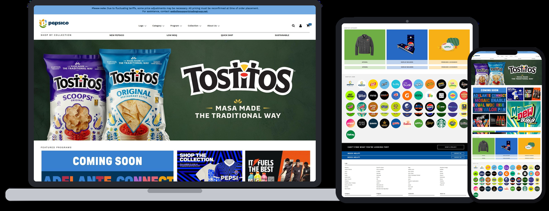
Accessing and ordering through Shop Pepsico Premium (SPP)
New users register with a @pepsico.com email. Returning users sign in with GPID.
Visit and Log In
Browse
Select Item
Review Cart
Complete Order
1
2
3
4
5
  Open the store and Sign In with GPID. New here? Create your account first.
  Shop by Logo, Category, Collection, Program, or Search to find items fast.
  Check MOQ, ship time, colors, and sizes. Set size and quantity, then Add to Cart.
  Open the cart at top right. Choose a single address or multiple addresses.
  Choose your payment method and complete your order.
Shop the live store on any device
Scan to register and shop
shoppepsicopremiums.com

Slide 6




Shop by Collection
Find the right items fast. Four ways to shop on SPP.
New PepsiCo
Latest drops across all brands
Low MOQ
Order as few as 24 units
Quick Ship
Ships in 10 days or less
Sustainable
Good for the planet and people
Find these under Shop by Collection on SPP.

Slide 7
Ways to order
SPP is our digital catalog of brand-approved merchandise, on phone, tablet, or desktop. You can always order direct.
Browse
Start a Project
Call your team
THE CATALOG ON SPP
ON SPP
SKIP THE INBOX
Every brand-approved item, ready to order on any device. If it is there, it ships.
Click Start a Project for anything the catalog does not carry. The team responds within 24 hours to scope and source it.
Skip the inbox. Call your team. They scope, source, and place it for you. No portal required.
How to choose
Ready to order → Browse the catalog
Need something custom → Start a Project
Anything urgent → Skip the inbox, call your team
Nothing is lost: everything the old catalog did is now on SPP or one call away, with brand approval and one invoice path built in.

Slide 8
Urgent and customer-funded orders, handled.
The two situations that send spend off-contract. Here is the path that keeps it in.
1
Quick Ship for rush
2
Skip the inbox. Call your team.
Use the Quick Ship collection on SPP. Ships in 10 days or less, no special handling needed.
For anything urgent, do not wait on email. Call your named lead and we scope an expedite the same day.
3
Customer-funded routing
4
TPM needs no PO
When a customer funds the order, we route the invoice straight to them, never your open PO.
The invoice generates without a PO and your manager gets the confirmation.

Slide 9





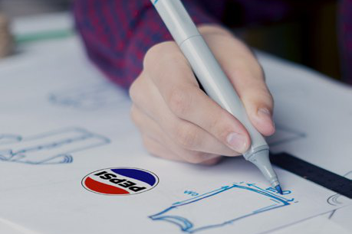
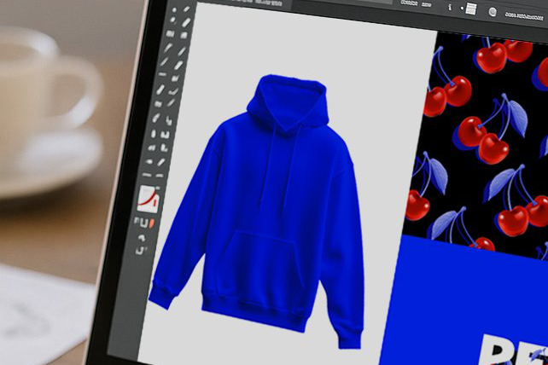
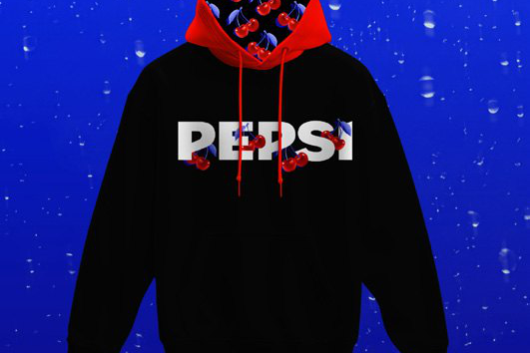
Can't find it? We Make it .
Browse
Shop the catalog first to see what is ready to order.
Start a Project
Click Start a Project on SPP for anything the catalog does not carry.
Send your brief
Share product, quantity, timing, and budget.
We scope it
The team responds within 24 hours to scope and source it.
We make it and deliver
We prototype, produce, and deliver. On brand, on time.
From a blank page to delivered
Three steps, on brand, in your hands.
01 Sketch
It starts as a blank page
02 Sample
We design and prototype it
03 Shelf
We produce and deliver it

Slide 10
How you save by working through us.
Real levers, not a promise. This is how working through us protects your budget.
1
Cost-saving targets
2
A competitive bid process
Procurement sets a cost-saving target for this category. Your order is measured against it.
We run a multiple-bid process depending on timing, so pricing is tested, not assumed.
3
We ask about budget first
4
Run by buyers
We always ask if there is a strict budget, then build to it.
Rishi and Melissa ran Procurement in the Americas. Finding savings is the job, not a favor.

Slide 11
Ways to pay
Three checkout paths. Pick the one that fits the order.
Pay by Invoice
Pay by Invoice
Credit Card
WITH A PO
TPM FUNDS ONLY
PERSONAL USE ONLY
Submit your official PO at checkout, addressed to ADM Promotions USA Inc, PepsiCo Vendor #2000016753. No quote required. Invoice sent to PepsiCo Finance for Payment.
No PO required for TRADE PROMOTION MANAGEMENT-funded orders. An invoice is generated without a PO, shared with you to process it for payment, and your manager receives the confirmation. All non-TPM orders require a PO at checkout.
Personal orders only. A processing fee applies at checkout.
How to choose
Have a PO → Pay by Invoice, with a PO
TPM-funded order → Pay by Invoice, TPM only
Personal order → Credit Card, personal use
PepsiCo policy: invoice without a PO is for TPM-funded orders only. Credit cards are for personal use only. Retrospective POs are not permitted, so have your PO ready at checkout.

Slide 12
Invoicing: The Path from Order to Invoice
What makes an order ready, and what a valid PepsiCo PO looks like.
STEP 1
STEP 2
STEP 3
STEP 4
Order placed
Owner: PepsiCo
Delivery Note on all lines
Owner: adm-indicia
Goods receipt completed
Owner: PepsiCo
Valid PO matched
Owner: adm-indicia
WHAT A VALID PEPSICO PO LOOKS LIKE
AN ORDER IS READY TO INVOICE WHEN
Rule 1 10-digit number starting with 4
✓
A Delivery Note is created on every order line
Example format: 4504389494
✓
Goods receipt is completed by the buyer
Rule 2 M4 alphanumeric reference
✓
A valid PO is matched, or card payment is confirmed
Example format: M413604978
Matching one of these on the order prevents the most common invoice delays.
This is the process behind the joint invoice fix on the previous page.

Slide 13





Skip the Inbox. Call Your Team.
Who To Contact For ANYTHING and EVERYTHING
First response within 4 hours; Resolution within 72 hours
Bernadette Rae
Juan Suarez
Pummi Khanchandani
Melissa Pompei
BEVERAGE
ALL THINGS BEVERAGE BRAND RELATED
Senior Account Manager
Bernadette.Rae@adm-indicia.com
917-617-0086
FOOD
ALL THINGS FOOD BRAND RELATED
Senior Account Manager
Juan.Suarez@adm-indicia.com
203-219-2161
FOOD SERVICE
ALL THINGS FOOD SERVICE RELATED
Account Director
Pummi.Khanchandani@adm-indicia.com
437-983-3614
SHOPPEPSICOPREMIUMS.COM
ALL THINGS RELATED TO SPP
Senior Account Manager
Melissa.Pompei@adm-indicia.com
908-489-3718
ESCALATION
PATH
If your rep is unavailable
Melissa Pompei
SPP, Senior Account Manager
Melissa.Pompei@adm-indicia.com
908-489-3718
Pummi Khanchandani
Food Service, Account Director
Pummi.Khanchandani@adm-indicia.com
437-983-3614
Rishi Gopaul
VP
Rishi.Gopaul@adm-indicia.com
718-791-0497
1
2
3

Slide 14
A team you can reach.
01
Beverage
Bernadette Rae · bernadette.rae@adm-indicia.com · 917-617-0086
02
Food
Juan Suarez · juan.suarez@adm-indicia.com · 203-219-2161
03
SPP & Store Support
Melissa Pompei · melissa.pompei@adm-indicia.com · 908-489-3718
Named people, clear paths.
Response times you can hold us to, and a face for every sector.
04
Food Service
Pummi Khanchandani · pummi.khanchandani@adm-indicia.com · 437-983-3614
05
Escalation
Rishi Gopaul · rishi.gopaul@adm-indicia.com · (718) 791-0497
RESPONSE STANDARDS
First reply under 30 minutes (target 4 business hours)
Resolution under 18 hours (target 72 business hours)
Skip the inbox. Call your team.
06
Order & site support
Scott Critzman · scott.critzman@adm-indicia.com · (475) 237-9395
07
Account & merch team
New products and custom briefs · pepsico.merch@adm-indicia.com

Slide 15
Questions? Start here.
When in doubt, reach us first. The store is the fastest path, and we respond within 24 hours.
Can't find the item you want?
Click Start a Project and send a quick brief. If it is not in the catalog, we build it.
When should I use Start a Project?
For custom or non-catalog needs, or when catalog pricing, MOQs, or lead times do not fit.
Why use SPP instead of sourcing locally?
Approved, brand-compliant suppliers with custom and quick-ship options. Local sourcing risks off-brand product and off-contract spend.
Who do I contact for invoicing, orders, tracking, or delivery?
Order and Site Support: pepsicoclientservices@adm-indicia.com.
Who is my representative, and how fast?
Your sector contact. The Merch Team inbox reaches all managers within 24 hours.
Where do I find low-minimum or quick-ship items?
Shop by Collection: Low MOQ (24 or fewer) and Quick Ship (10 days or less).
Can I ship one order to several locations?
Yes. At the cart, choose multiple addresses and split the quantities by site.
New to SPP?
Register with your @pepsico.com email or sign in with GPID if you use PepsiCo SSO.
Need it urgent, or is a customer funding it?
Skip the inbox. Call your team. We scope an expedite the same day, and route customer-funded invoices straight to the funder, never your PO.
Can I order directly?
Yes. SPP is our digital catalog of brand-approved merchandise, on phone, tablet, or desktop. Order there or skip the inbox and call your team.
Do I need a PO?
Use a PO for standard orders. TPM-funded orders need no PO, the invoice generates without one and your manager gets the confirmation.
When will my order ship?
Quick Ship items ship in 10 days or less. For anything time-critical, skip the inbox and call your team for a verified date.
More FAQ’s can be found HERE

Slide 16
Thank you

